Slide 1

Karim El-Chami
Predicting Best Airbnb Location in Osaka City, Japan

Slide 2
Introduction
Osaka is Japan's second largest metropolitan area after Tokyo.
It has been the economic powerhouse of the Kansai Region for many centuries.
Over 9.4 million foreign tourists visited Osaka last year, the largest number ever, Osaka tourism authorities announced.
The figure represents a 31 percent increase on 2015, and is more than triple the number of foreign nationals who visited the city in 2013
Osaka has a lot of tourist attractions, but most importantly, Osaka is known as “Japan’s kitchen” and many food enthusiasts come here just to eat.
In this Report I’ll predict the best Ward/Neighborhood to host an Airbnb (Vacation rental) for tourists from all over the world

Slide 3
Data Cleansing
Data Sources:
All the neighborhoods of Osaka from https://en.wikipedia.org/wiki/Category:Wards_of_Osaka
The coordinates (latitude and longitude) are from Open Street Map APIs: http://nominatim.openstreetmap.org/search.php?q=
Foursqaure’s API to get the following venue data:
Historic Site: 4deefb944765f83613cdba6e
Theme Park: 4bf58dd8d48988d182941735
Ramen Restaurant: 55a59bace4b013909087cb24
Okonomiyaki Restaurants: 55a59bace4b013909087cb18

Slide 4
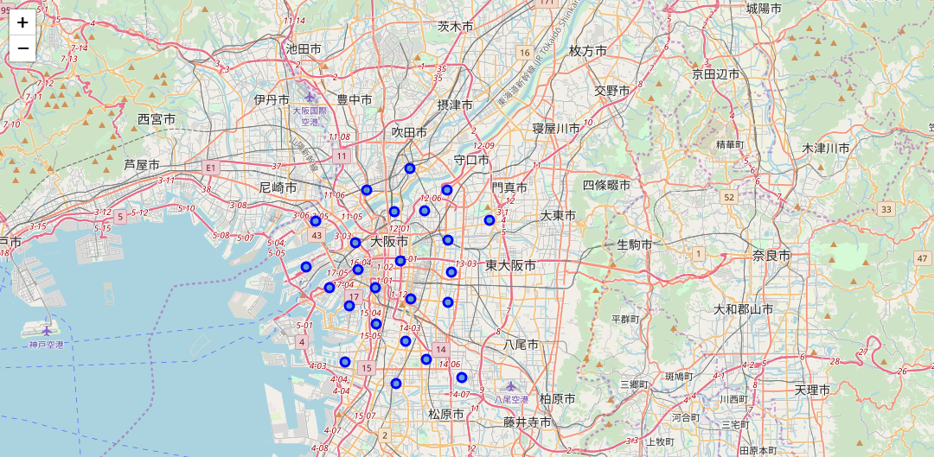
Wards

Slide 5
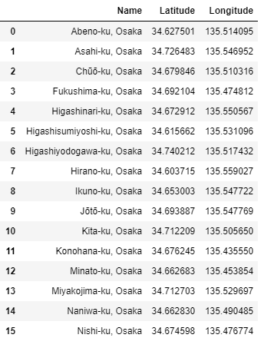
Wards

Slide 6
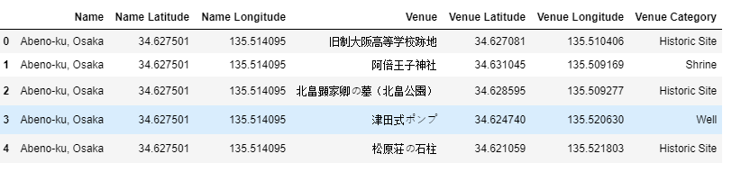
Historic Site Venues

Slide 7
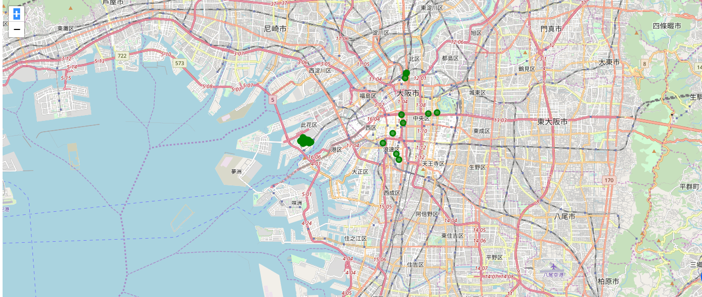
Theme Park Venues

Slide 8
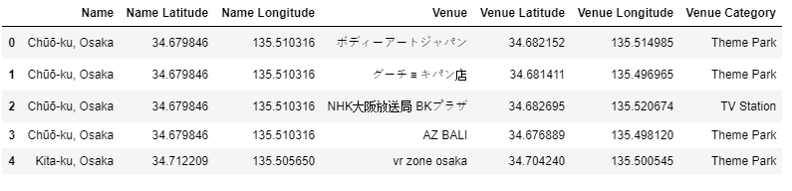
Theme Park Venues

Slide 9
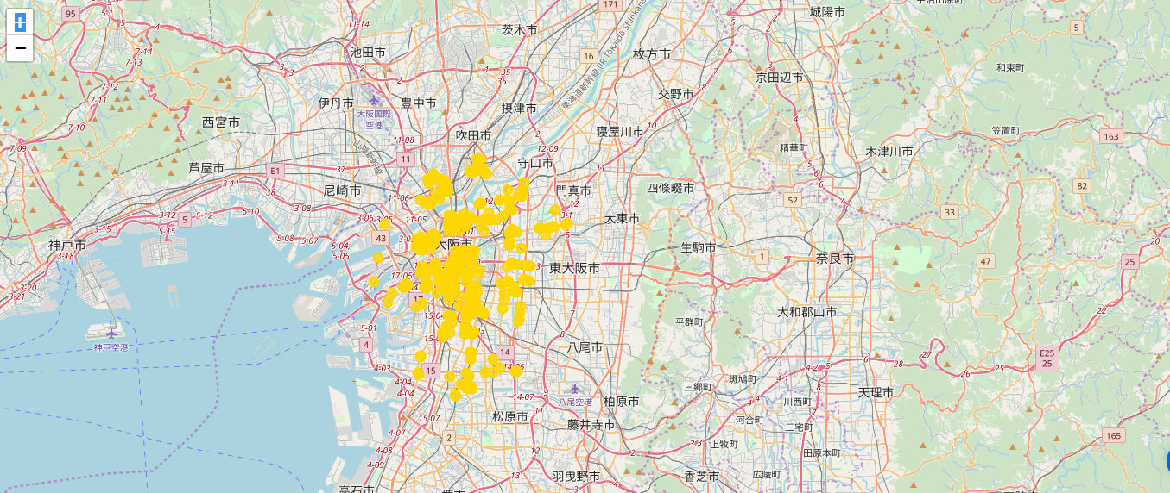
Ramen Restaurants Venues

Slide 10
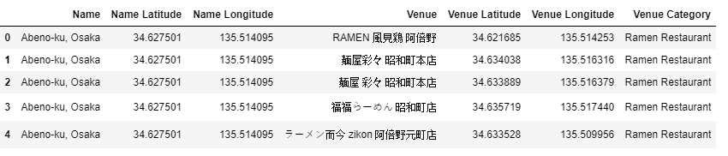
Ramen Restaurants Venues

Slide 11
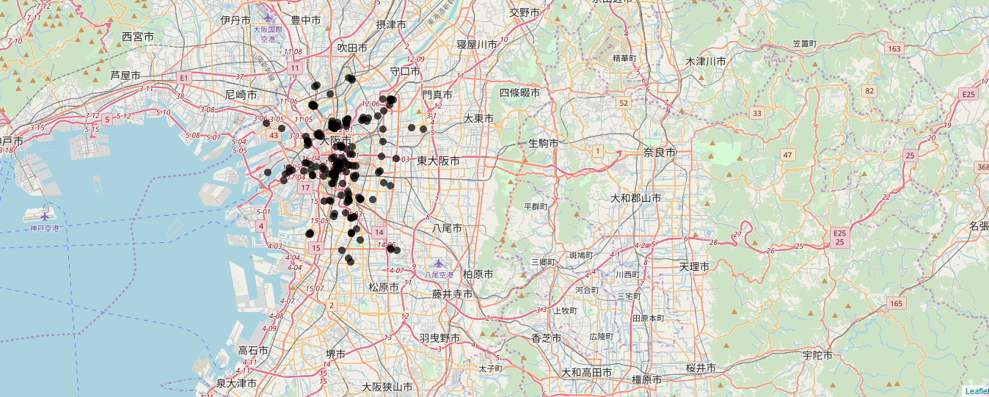
Okonomiyaki Restaurants Venues

Slide 12
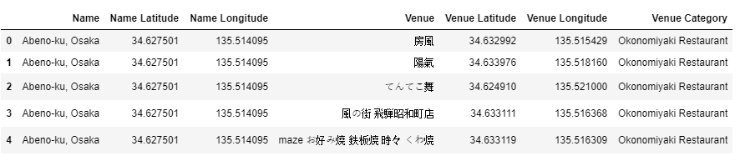
Okonomiyaki Restaurants Venues

Slide 13
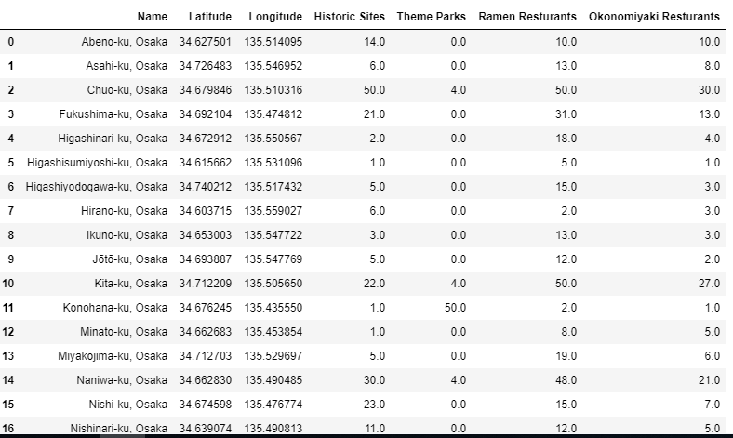
Sum of Venues per Category per Ward

Slide 14
Conclusion
The sum of score was calculated for all the venues from all the categories per ward to determine the suggested ward to host the Airbnb at. Therefore, Chuo ku Ward is our best and recommended ward to host our Airbnb rental at since it has the most historic sites, Theme parks, restaurants, and tourists will most likely would want to stay there as it’s close to all touristic attractions.

Slide 15
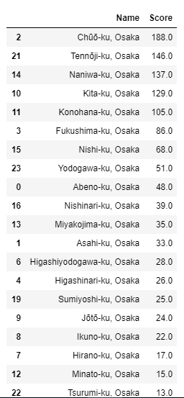
Chuo ku Ward

Slide 16
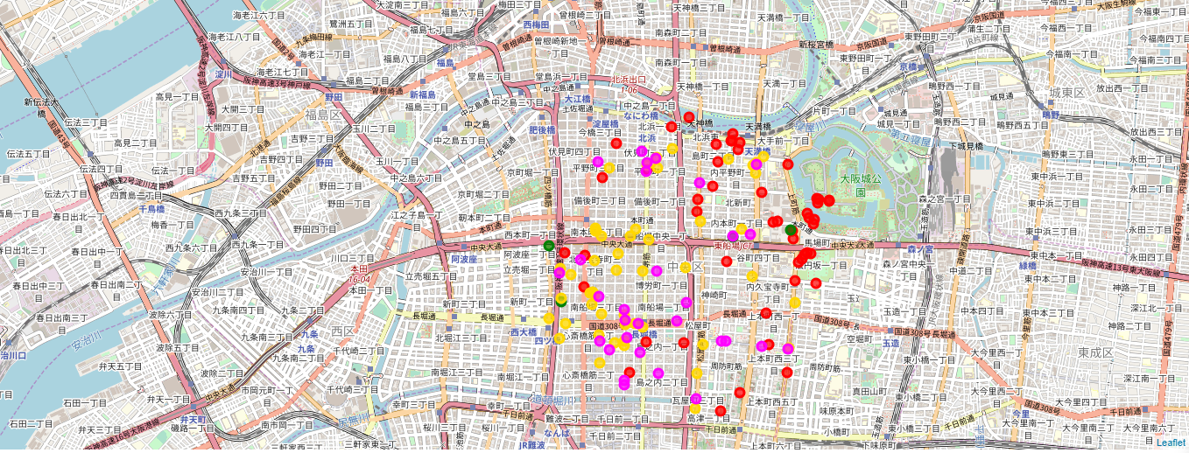
Chuo ku Ward

